Slide 1
Course Overview
Computer Security: Techniques and Tactics

Slide 2
Introduction
ME = Tiffany Bao
How to reach me: Slack + tbao@asu.edu
My email only accepts questions that are private or embarrassed to ask in public.
All other question goes to Slack.
People who are active in answering questions in Slack may have extra bonus.
Office Hours: Mon 4pm-5pm or by appointment (Email me to set up time).
Location: Brickyard 482 or 484

Slide 3
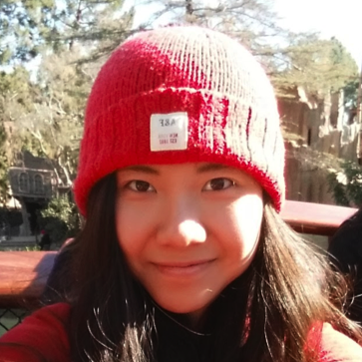
About Myself
B.S., Peking University, 2012
Ph.D., CMU, 2018
Research: software security
Web: https://tiffanybao.com
Keywords: Binary analysis, game theory

Slide 4
Example of Current Research
The Architect is the designer of the dream space. An architect is similar in this regard to a video game designer, with the dream representing different levels within the game, complete with all the aesthetic and tactile details.

Slide 5
Example of Current Research
Finding vulnerabilities from software program
How to find more vulnerabilities automatically?
Dealing with discovered vulnerabilities (zero-day vulnerabilities)
Whether and when to disclose a vulnerability?
Cyber Warfare
Vulnerability lifecycle prediction
How long does a vulnerability exist in a system?

Slide 6
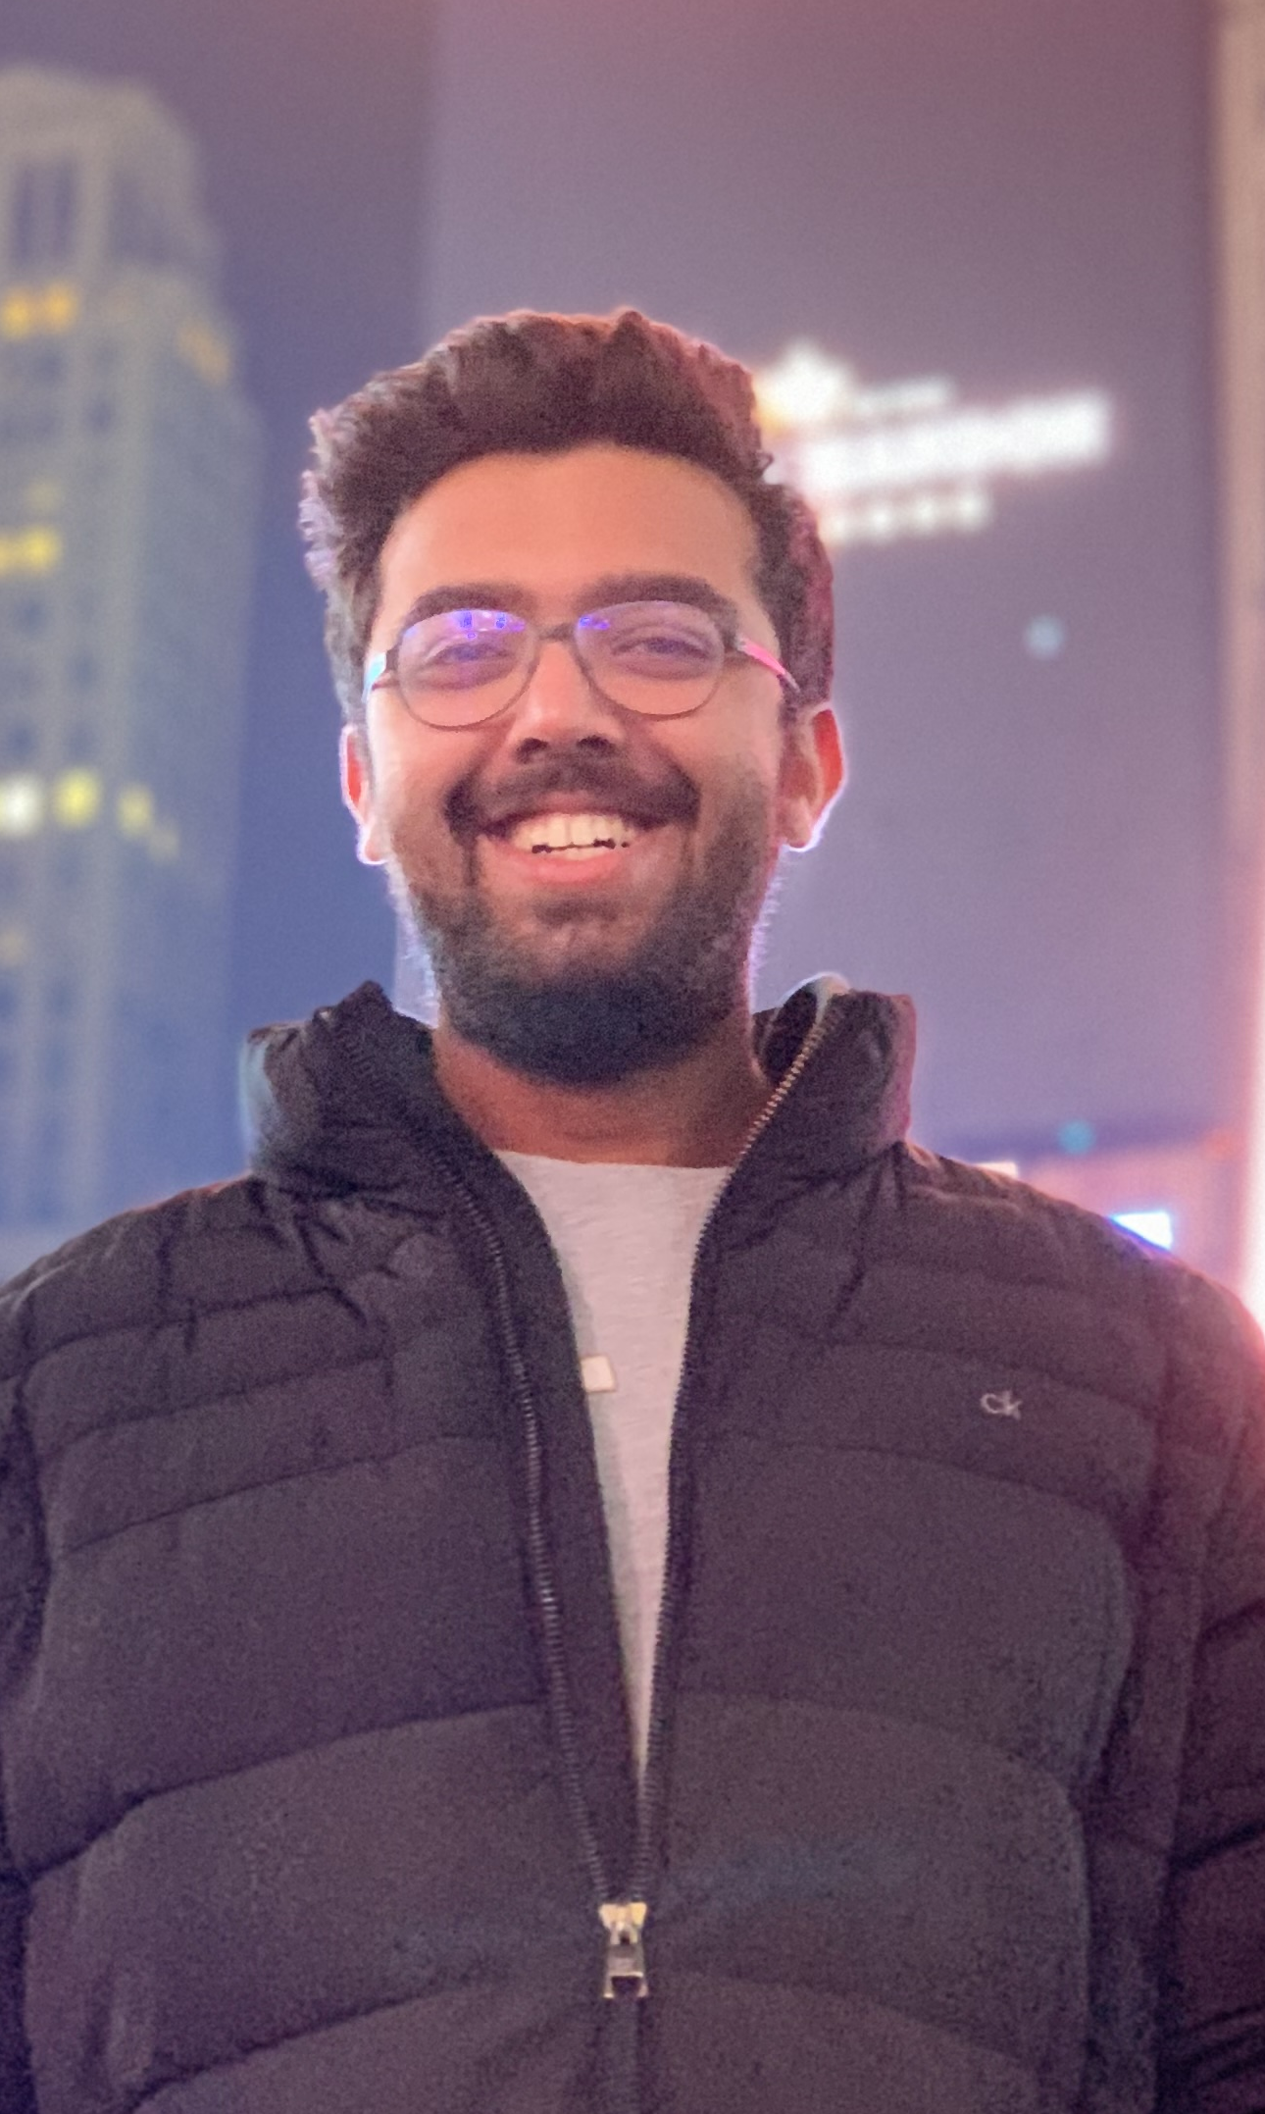
TA
Gokul Krishna P
Bachelors in CS from Amrita University, 2018
Currently research intern at SEFCOM, ASU
Research: System Security
Web: zer0xlab.com

Slide 7
Today’s Class
Course personnel introductions
Course expectations
Course setup
Grading and course policies
Projects

Slide 8
Course Expectations
Understand how techniques and tactics co-work in computer security.
Learn the current solutions for computer security.
Critically understand those research.
Coming up insights on computer security.
Topic-based, project-oriented.

Slide 9
Projects
Software Security
Computer Security

Slide 10
Today’s Class
Course personnel introductions
Course expectations
Course setup
Grading and course policies
Projects

Slide 11
Team up for Course Projects!
2-3 people a team, ~1 month per project.
Everyone will work on 3 problems through the semester.
Choose from my list (10 research problems/projects).
Or pitch to me your own idea!
Schedule an office hour and prepare for a 5-minute pitch.

Slide 12
Pitching Your Own Idea (The Heilmeier Catechism)
What are you trying to do? Articulate your objectives using absolutely no jargon.
How is it done today, and what are the limits of current practice?
What is new in your approach and why do you think it will be successful?
Who cares? If you are successful, what difference will it make?
What are the mid-term and final “exams” to check for success?

Slide 13
Project Work
Read related papers
A list of what you have read (“Reading List” in the cse 591 shared folder)
Present the topic (1 class)
Presentation slide (“Topic Presentation” in the cse 591 shared folder)
A multiple-choice question to the audience (show it up during class)
Propose project idea (30 min)
Presentation slide (“Proposal Presentation” in the cse 591 shared folder)
Implement the idea
Code repository (github under the cse-591 group)
Report the project (30 min)
Presentation slide + Demo/Numbers (“Report Presentation” in the cse 591 shared folder)

Slide 14
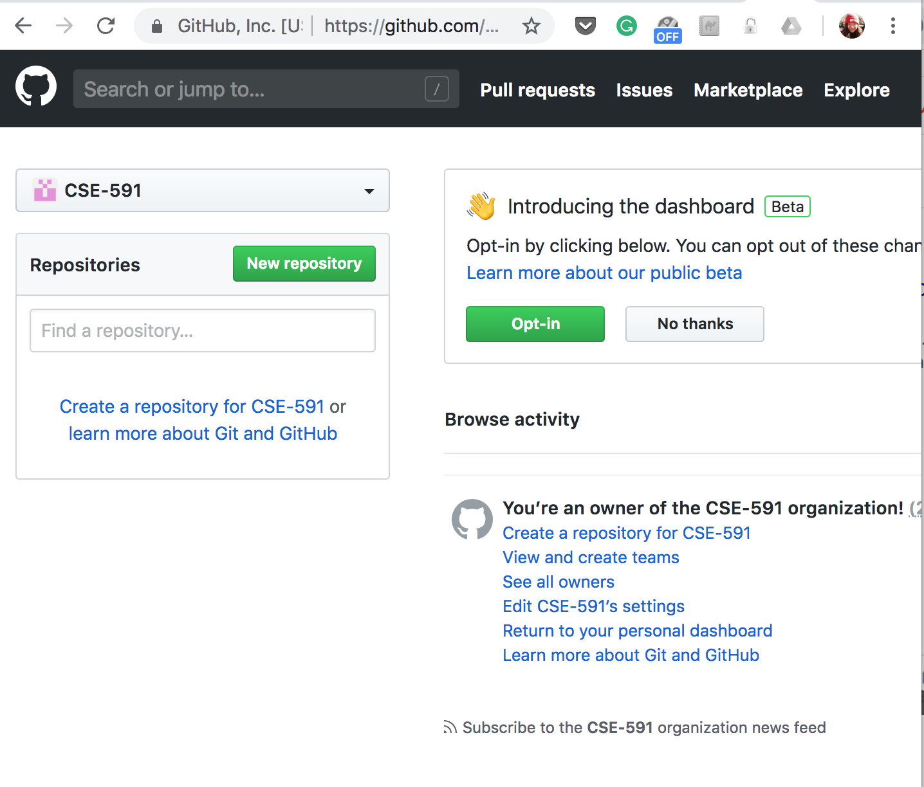
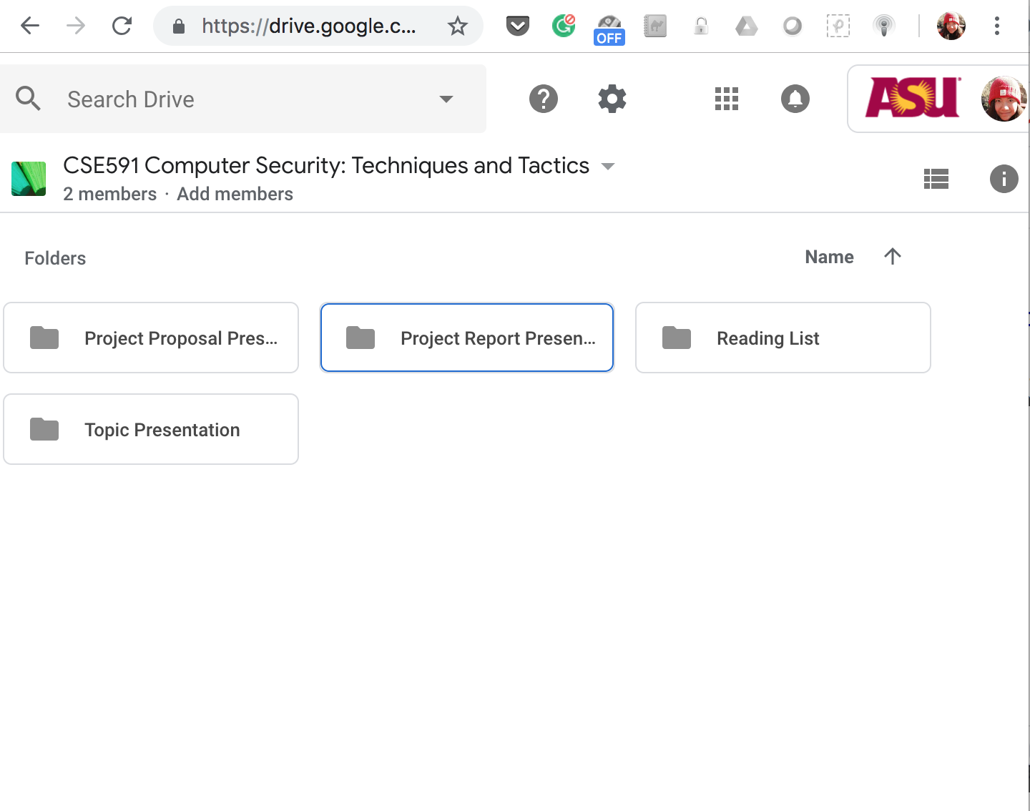
Email me with your asu email and Github account

Slide 15
Prerequisites
At least one of the following:
Software security
Game theory
Data analysis
Machine learning

Slide 16
Prerequisites
Expect to write code
All projects will require to code
Everyone should contribute to code (I may check github commits)
Expect to self-learn
Literature search
Read papers
Ask around
etc.

Slide 17
Today’s Class
Course personnel introductions
Course expectations
Course setup
Grading and course policies
Projects

Slide 18
Grade
No exam or homework
30% * 3 projects + 10% class participation
For each project:
Reading list 5%
Topic presentation 5%
Proposal presentation 5%
Project implementation 5%
Report presentation 5%
Demo 5%
Class participation is based on the in-class multiple choice

Slide 19
Poster Session
The end of the semester

Slide 20
Policy
The grade for each one in the same team may vary.
The demo or the plots should be reproduceable.
Provide how to run the demo with the repository commit in the report presentation.
E.g. “./demo.sh @ 2ca41f1”

Slide 21
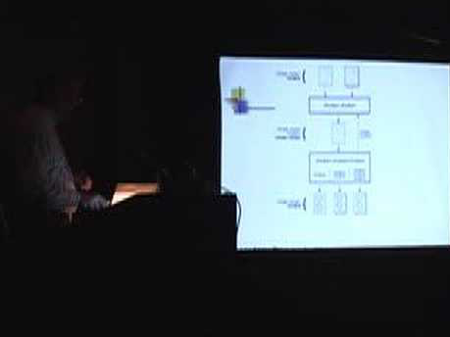
Class Break
Topic presentation: check any class
Proposal and report presentations:

Slide 22
Today’s Class
Course personnel introductions
Course expectations
Course setup
Grading and course policies
Projects

Slide 23
1. Finding crashes in the cutting-edge Linux
Crashes are unexpected. Let’s find them out!
Goal: Find crashes from Linux packages
Example:
Since there are so many Linux packages/binaries, can you make the finding automatic?
Possible direction:
Argument fuzzing
Legacy packages
tiffanyb@debian9$ e2ps "`cat argv_1.symb`" "`cat argv_2.symb`" < file___dev__stdin.symb 1>/dev/null
Segmentation fault
tiffanyb@debian9$ e2ps -v
e2ps's version is 4.34 (08/21/2002).

Slide 24
2. Function Reuse in Linux Binaries
Don’t reinvent wheels --- We reuse code a lot
How many functions are duplicated in Linux?
Two kinds of function duplication
Copy-paste function from package to package
One package generates multiple binaries, and binaries have overlapping functions
E.g., binutils
Goal: Function reuse map for Linux packages
Possible direction:
Source code level function comparison

Slide 25
3. Predict the Fuzzer
Fuzzing: Generate a lot of inputs and test them on a program
Coverage-based fuzzing: the input is generated on the purpose of covering more part of the tested code.
But fuzzing has limitation
Goal: given a code and a fuzzing tool (e.g. AFL, American Fuzzy Lop), predict which part of the code that the tool will be hard to reach.
Possible Direction: Machine learning
https://medium.com/@dieswaytoofast/fuzzing-and-deep-learning-5aae84c20303

Slide 26
4. Tame the Fuzzer
We know there are places that fuzzer is hard to reach, but we still hope to generate some inputs that reach around these places so that we could apply more expensive bug finding techniques later on.
Goal: Given a binary, an arbitrary code position, and a fuzzer like AFL, can we generate an input that reach around the code position?
Possible Direction:
Let the fuzzer to generate some inputs, learn the relationship between the generated inputs and the code position, or
Update the fuzzing strategy to be code position-related, e.g. using genetic algorithm.
https://geektyrant.com/news/how-to-train-your-dragon-3-gets-official-title-and-release-date

Slide 27
5. Crash Input Minimization
The crash that a fuzzer finds may not be the simplest
E.g. Both ./vuln AAAAA ./vuln AAAAAAAAAAAAAAA triggers the vulnerability, but the first one dynamically executes less instruction.
Goal: Simplify crash input
Possible Direction:
Learn how afl-tmin works
#include <stdio.h>
#include <string.h>
#include <stdlib.h>
int main(int argc, char *argv[]){
char buffer[5];
int len = strlen(argv[1]);
for(int i = 1; i < len; i++)
buffer[i] = argv[1][i];
return 0;
}

Slide 28
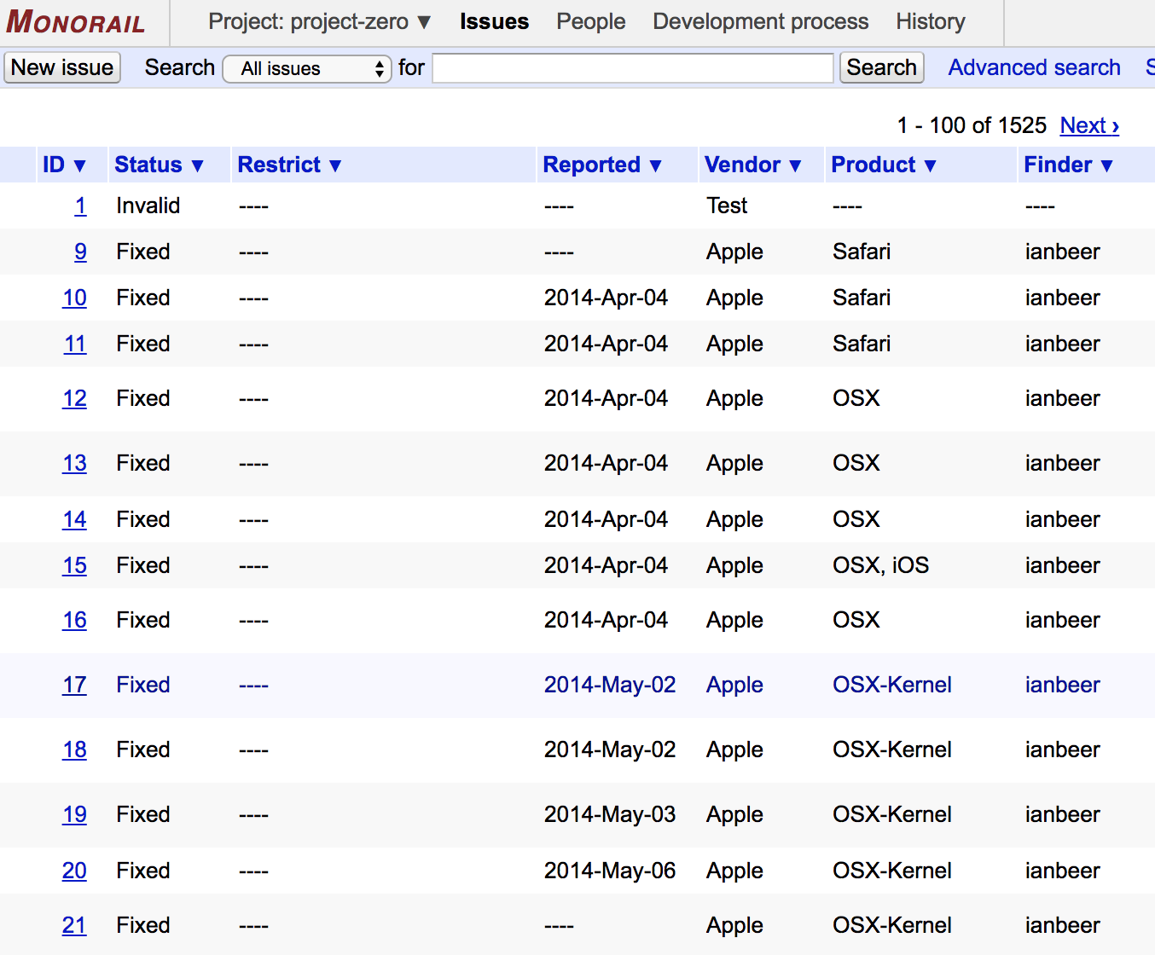
6. Vulnerability Longevity Prediction
Vulnerability longevity: from the date a vulnerability is discovered to the date a vulnerability is disclosed to a vulnerability database such as CVE.
Goal: Given a vulnerability, predict vulnerability longevity.
Possible direction:
Machine learning / Data mining on collected data of the existing vulnerabilities from the internet

Slide 29
7. Zero-day Vulnerability Purchase Game
Governments purchase zero-day vulnerabilities from black markets for national defense/offense purposes.
Meanwhile adversaries also purchase zero-day vulnerabilities.
Limited budget, what vulnerabilities should a government choose?
Goal: propose algorithms and plot for the results for different value inputs
Possible Direction: Knapsack problem.
Notes:
Suppose one have 1M dollars and there are 200 zero-day vulnerabilities to choose. Given a limited budget, what vulnerabilities should a government select?

Slide 30
8. Attacking Strategy Synthesis
In a network, attackers need to decide attacking strategy
Which node should I attack first?
After the first node, what should I do next?
Goal: Build up network scenarios, invite people to play your setup and observe how they play.
Possible Direction: I will provide network setup testbed and some people resources
https://simple.wikipedia.org/wiki/Network_topology

Slide 31
9. Vulnerability Discovery Collision Prediction
It is possible that different parties find the same vulnerability.
Goal: Given a binary and its vulnerability, predict the likelihood that the vulnerability is discovered by multiple parties.
Possible direction:
Collect and Analyze CTF competition data.
Find the number of teams for each CTF exploitation challenge.
How to quantify the hardness level by technically analyzing the binary and the vulnerability?

Slide 32




10*. CGC Game Simulation (Counted for 2-3 projects)
The Cyber Grand Challenge: a defense-offence game with specific rules
7 teams, ~100 vulnerabilities, 95 rounds
Each team discovered vulnerabilities and attacked/patched machines
A great competition, but little has been studied on the game strategy
Goal:
Develop a game simulation platform adapting with Cyber Grand Challenge (Project 1)
Reproduce the Cyber Grand Challenge Final Game (Project 2)
Interpret each team’s strategy and propose a new strategy to play against the teams (Project 3)
Offense Score
Attack
Attack
Patch
Defense Score
Performance Score
Total Score

Slide 33
Question about each project
Publicly ask through slack
Join Slack

Slide 34
Your TODOs
Email both Gokul and me with:
GitHub account (for code)
ASU email account (for shared folder)
Your 3 favorite project, or ask Tiffany for pitching
The successful pitching project will show up in the next project cycle
Gokul: gpraveen@asu.edu
Tiffany: tbao@asu.edu
Join Slack
Ddl: before next class
We will announce the first project’s teaming results in the next class

Slide 35
Questions?

